Slide 1
MPOPF Simulation and OpenDSS Validation
Aryan Ritwajeet Jha
Graduate Research Assistant
Washington State University
Notes:
Remember to hit the reset button to make sure all the page elements react properly.
There are 20 different layouts that you can choose from.

Slide 2
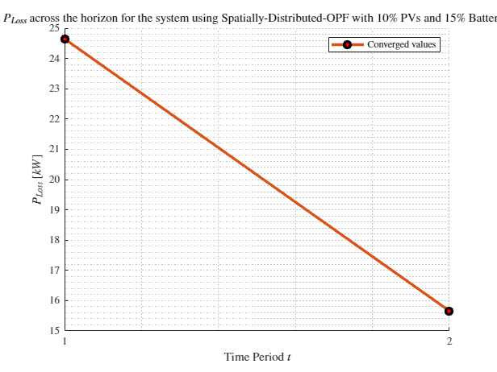
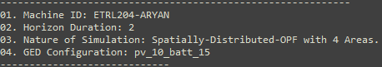
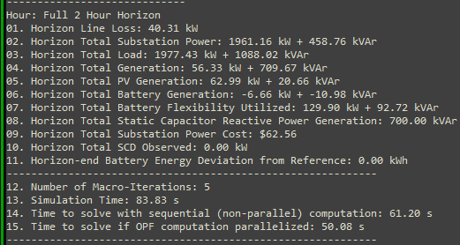
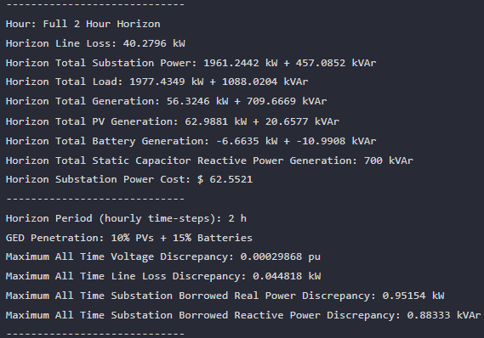

MPDOPF Verified for $T=2, PV=10\%, Batt=15\%$
strLoadShape = 'New Loadshape.LoadShape npts =2 interval = 1 mult = [1 0.7]'
strLoadShapePV = 'New Loadshape.LoadShapePV npts =2 interval = 1 mult = [1.4 0.8]'
MPDOPF Simulation Results
Alternative Profiles
OpenDSS Powerflow Results

Slide 3
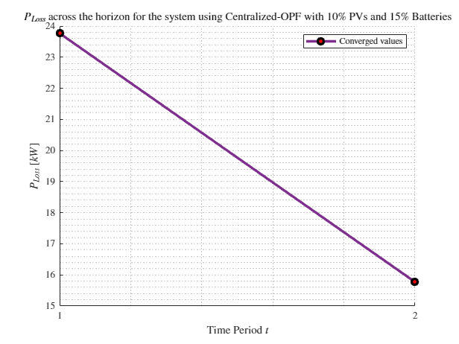
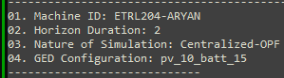
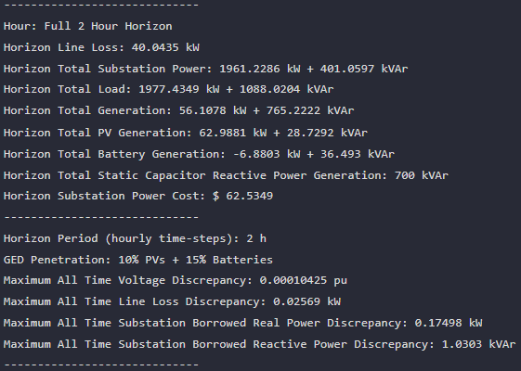
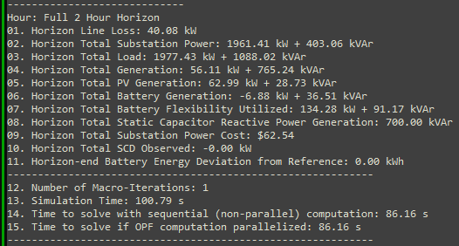

MPCOPF Verified for $T=2, PV=10\%, Batt=15\%$
strLoadShape = 'New Loadshape.LoadShape npts =2 interval = 1 mult = [1 0.7]'
strLoadShapePV = 'New Loadshape.LoadShapePV npts =2 interval = 1 mult = [1.4 0.8]'
MPCOPF Simulation Results
Alternative Profiles
OpenDSS Powerflow Results

Slide 4
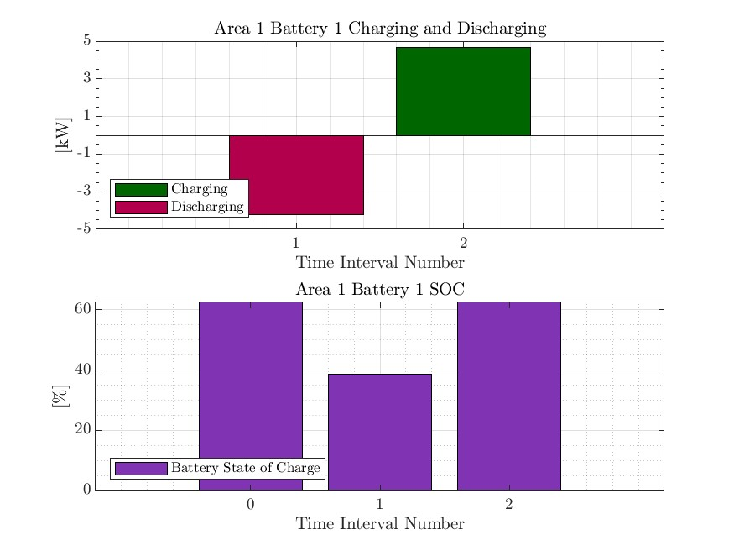
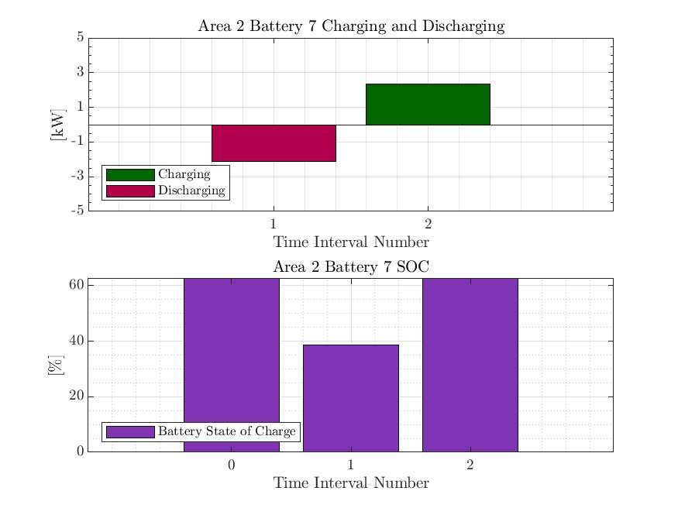



MPDOPF Verified for $T=2, PV=10\%, Batt=15\%$
strLoadShape = 'New Loadshape.LoadShape npts =2 interval = 1 mult = [1 0.7]'
strLoadShapePV = 'New Loadshape.LoadShapePV npts =2 interval = 1 mult = [1.4 0.8]'
Alternative Profiles

Slide 5




MPCOPF Verified for $T=2, PV=10\%, Batt=15\%$
strLoadShape = 'New Loadshape.LoadShape npts =2 interval = 1 mult = [1 0.7]'
strLoadShapePV = 'New Loadshape.LoadShapePV npts =2 interval = 1 mult = [1.4 0.8]'
Alternative Profiles

Slide 6
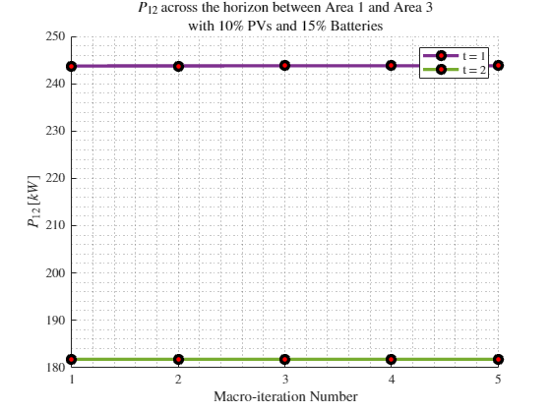
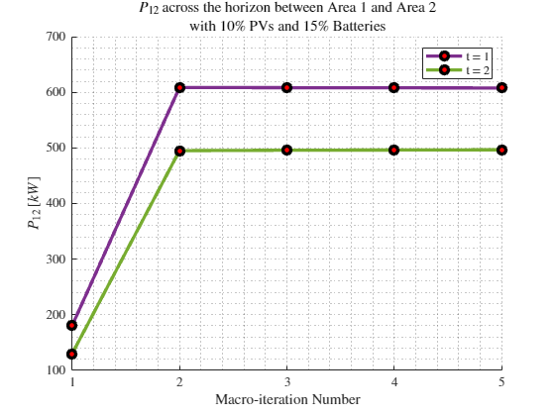
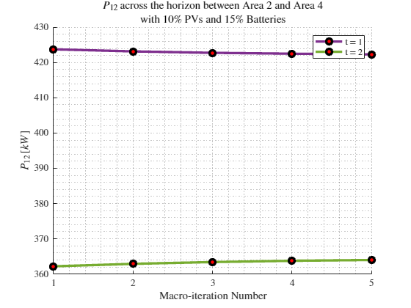

Boundary Complex Powers
strLoadShape = 'New Loadshape.LoadShape npts =2 interval = 1 mult = [1 0.7]'
MPDOPF Verified for $T=2, PV=10\%, Batt=15\%$
strLoadShapePV = 'New Loadshape.LoadShapePV npts =2 interval = 1 mult = [1.4 0.8]'
Alternative Profiles

Slide 7
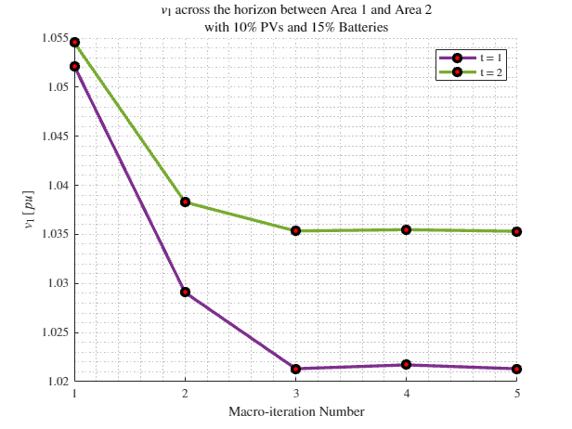
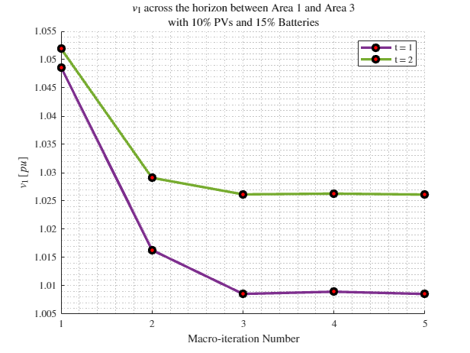
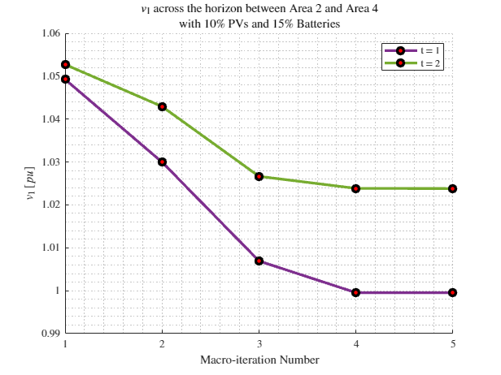
Boundary Voltages
strLoadShape = 'New Loadshape.LoadShape npts =2 interval = 1 mult = [1 0.7]'
MPDOPF Verified for $T=2, PV=10\%, Batt=15\%$
strLoadShapePV = 'New Loadshape.LoadShapePV npts =2 interval = 1 mult = [1.4 0.8]'
Alternative Profiles

Slide 8
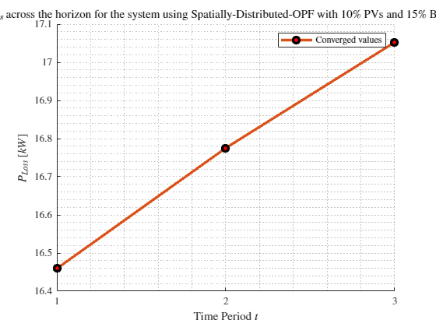
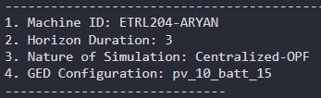
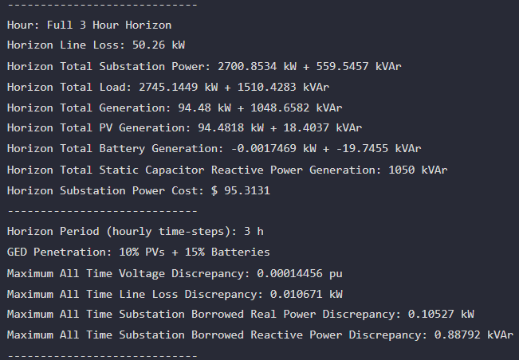
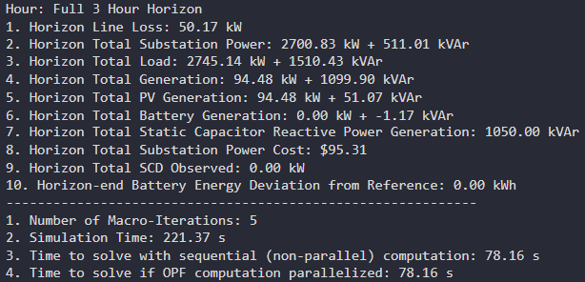

MPDOPF Verified for $T=3, PV=10\%, Batt=15\%$
strLoadShape = 'New Loadshape.LoadShape npts =3 interval = 1 mult = [0.777 0.787 0.796]'
strLoadShapePV = 'New Loadshape.LoadShapePV npts =3 interval = 1 mult = [0.8 0.9 1]'
MPCOPF Simulation Results
OpenDSS Powerflow Results

Slide 9
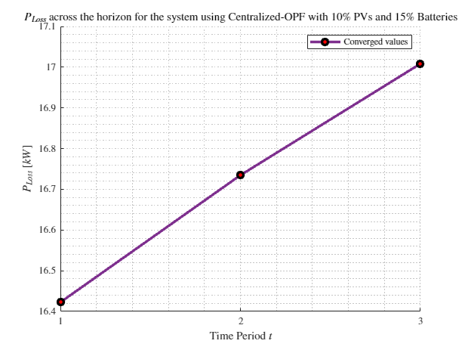
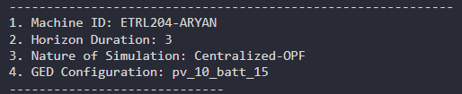
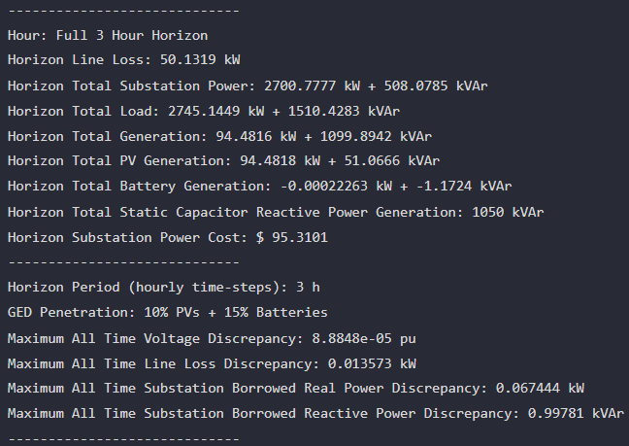
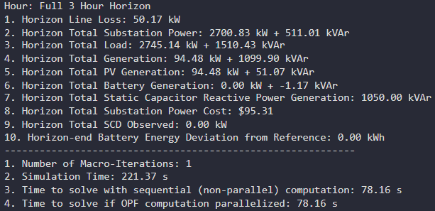

MPCOPF Verified for $T=3, PV=10\%, Batt=15\%$
strLoadShape = 'New Loadshape.LoadShape npts =3 interval = 1 mult = [0.777 0.787 0.796]'
strLoadShapePV = 'New Loadshape.LoadShapePV npts =3 interval = 1 mult = [0.8 0.9 1]'
MPDOPF Simulation Results
OpenDSS Powerflow Results

Slide 10
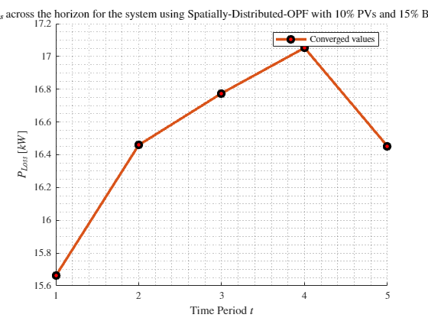
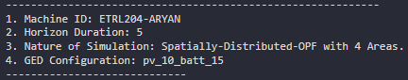
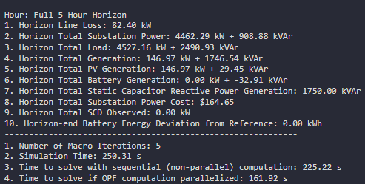
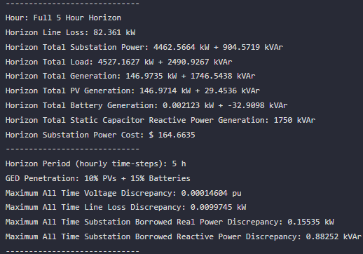

MPDOPF Verified for $T=5, PV=10\%, Batt=15\%$
strLoadShape = 'New Loadshape.LoadShape npts =5 interval = 1 mult = [0.75 0.777 0.787 0.796 0.782]'
strLoadShapePV = 'New Loadshape.LoadShapePV npts =5 interval = 1 mult = [0.5 0.8 0.9 1 1]'
MPDOPF Simulation Results
OpenDSS Powerflow Results

Slide 11
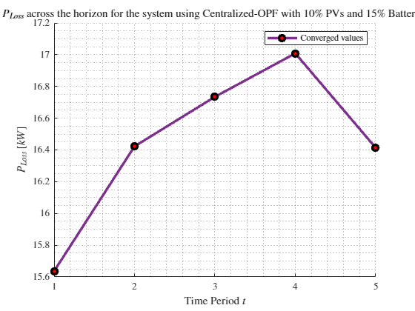
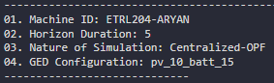
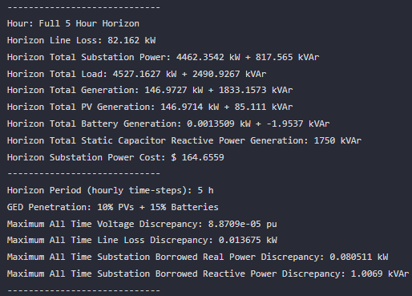
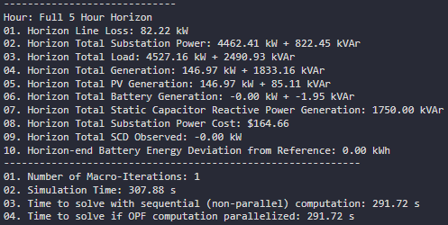

MPCOPF Verified for $T=5, PV=10\%, Batt=15\%$
strLoadShape = 'New Loadshape.LoadShape npts =5 interval = 1 mult = [0.75 0.777 0.787 0.796 0.782]'
strLoadShapePV = 'New Loadshape.LoadShapePV npts =5 interval = 1 mult = [0.5 0.8 0.9 1 1]'
MPCOPF Simulation Results
OpenDSS Powerflow Results

Slide 12
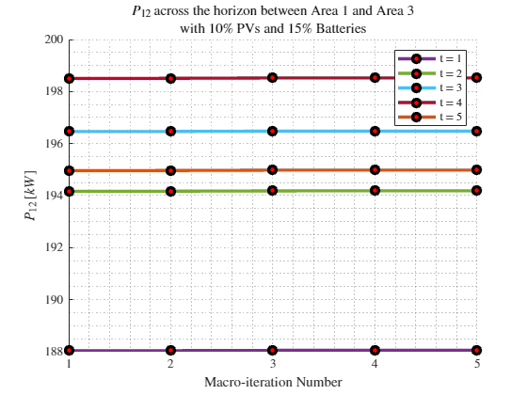
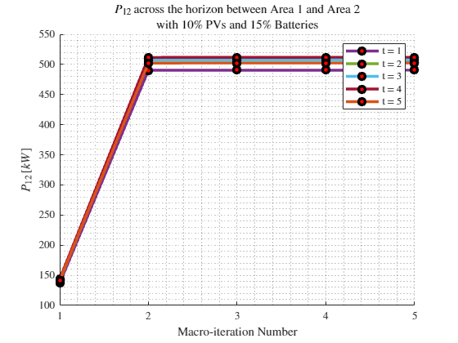
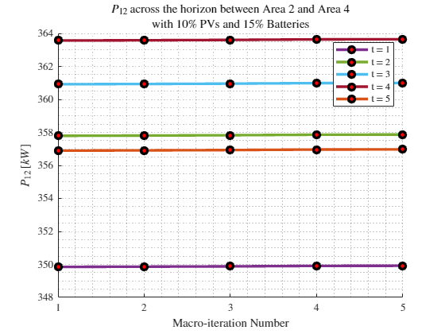

Boundary Complex Powers
MPDOPF Verified for $T=5, PV=10\%, Batt=15\%$

Slide 13
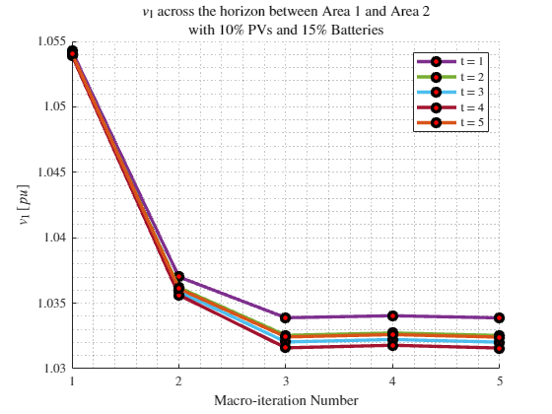
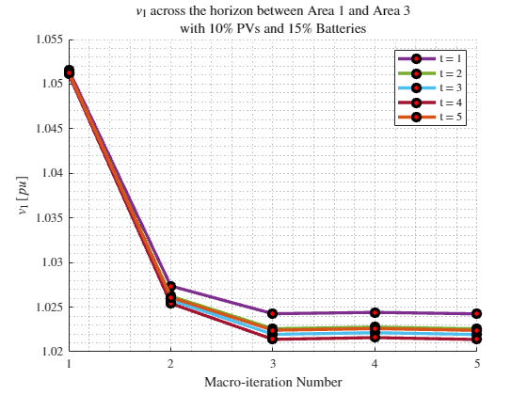
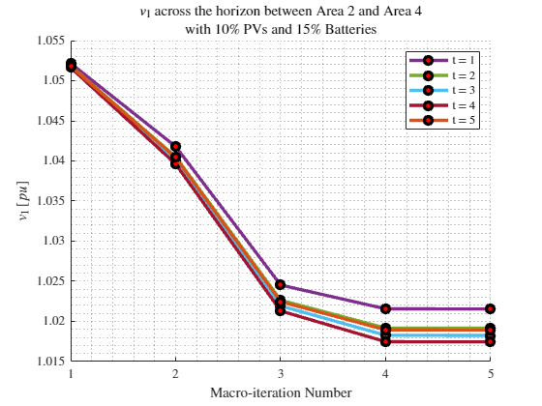
Boundary Voltages
MPDOPF Verified for $T=5, PV=10\%, Batt=15\%$

Slide 14
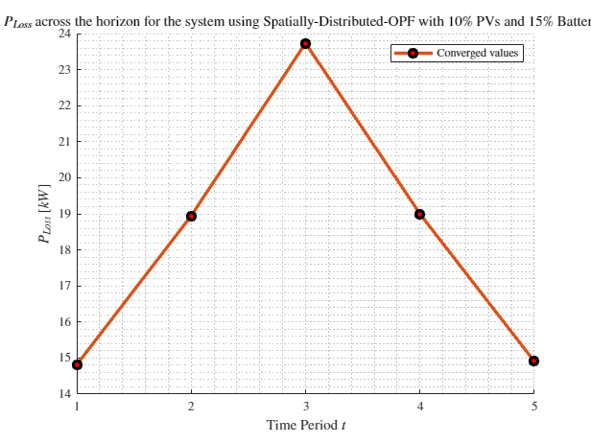
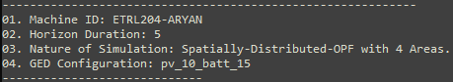
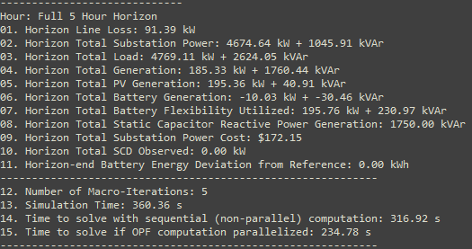
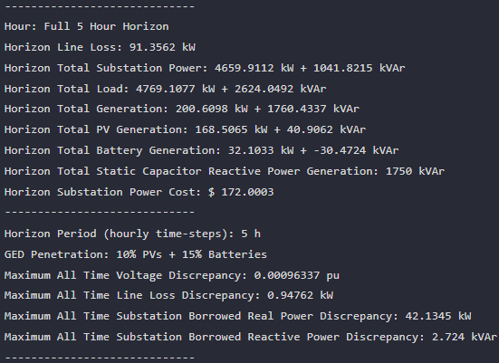
MPDOPF Verified for $T=5, PV=10\%, Batt=15\%$
strLoadShape = 'New Loadshape.LoadShape npts =5 interval = 1 mult = [0.7 0.85 1 0.85 0.7]'
strLoadShapePV = 'New Loadshape.LoadShapePV npts =5 interval = 1 mult = [1 1.2828 1.4 1.1 0.8]'
MPDOPF Simulation Results
Alternative Profiles
OpenDSS Powerflow Results

Slide 15
MPCOPF Verified for $T=5, PV=10\%, Batt=15\%$
strLoadShape = 'New Loadshape.LoadShape npts =5 interval = 1 mult = [0.7 0.85 1 0.85 0.7]'
strLoadShapePV = 'New Loadshape.LoadShapePV npts =5 interval = 1 mult = [1 1.2828 1.4 1.1 0.8]'
MPCOPF Simulation Results
Alternative Profiles
OpenDSS Powerflow Results

Slide 16
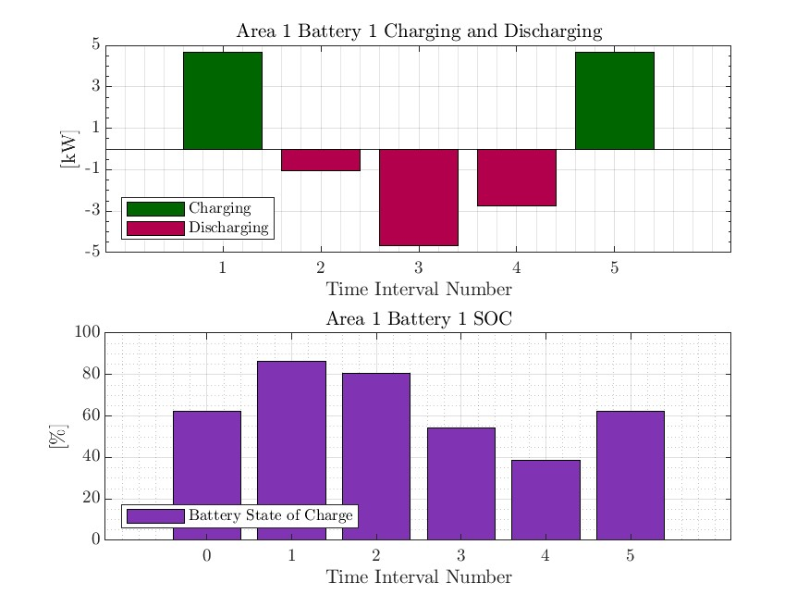
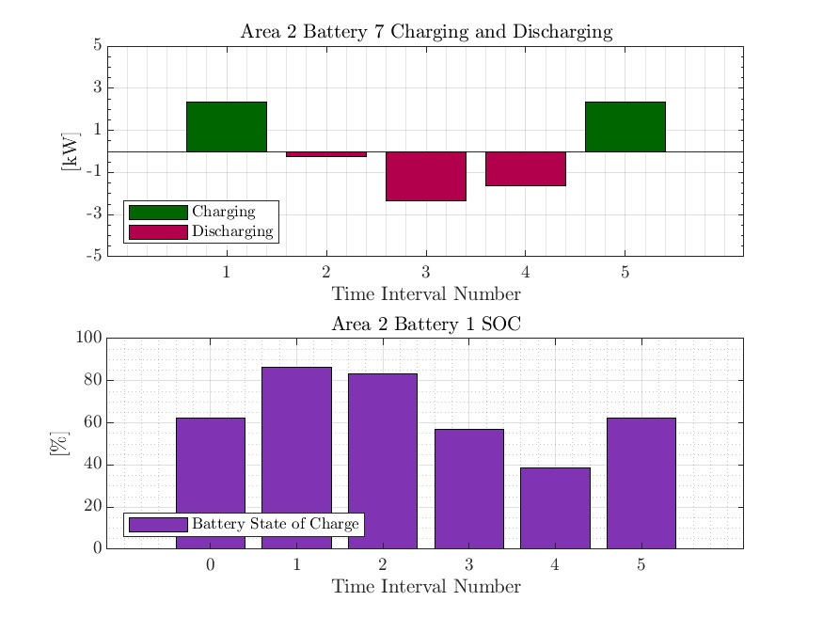
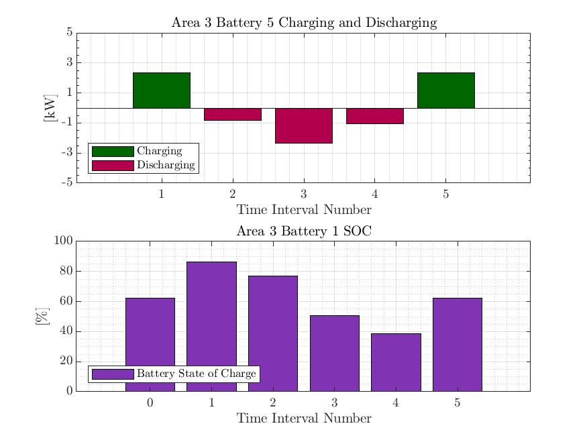
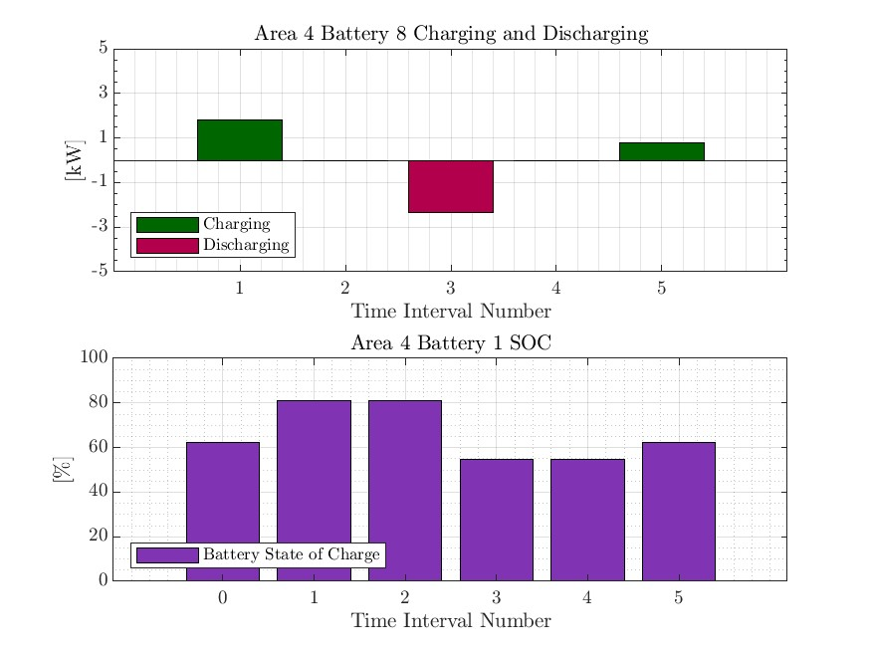

MPDOPF Verified for $T=10, PV=10\%, Batt=15\%$
strLoadShape = 'New Loadshape.LoadShape npts =5 interval = 1 mult = [0.7 0.85 1 0.85 0.7]'
strLoadShapePV = 'New Loadshape.LoadShapePV npts =5 interval = 1 mult = [1 1.2828 1.4 1.1 0.8]'
Alternative Profiles

Slide 17
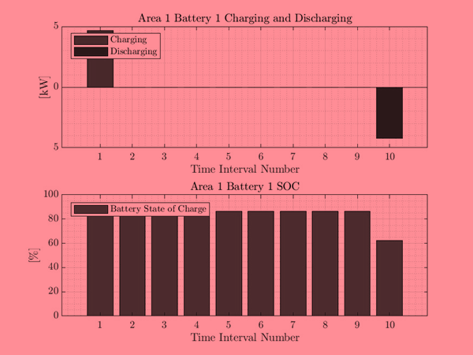
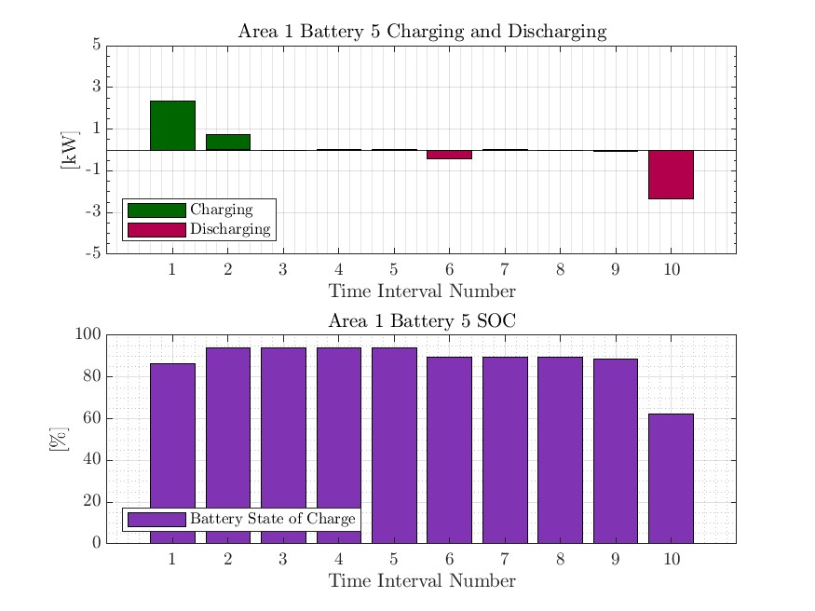
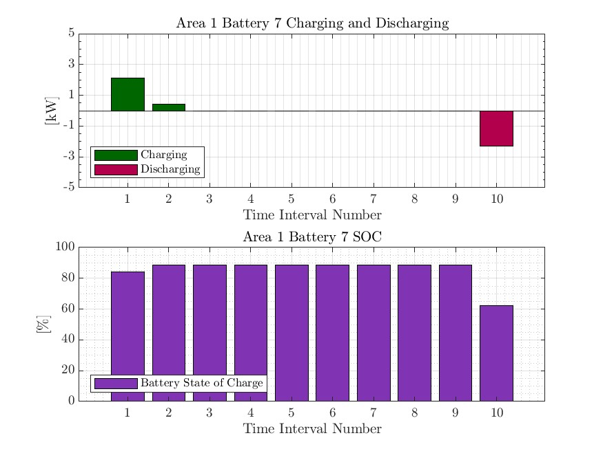
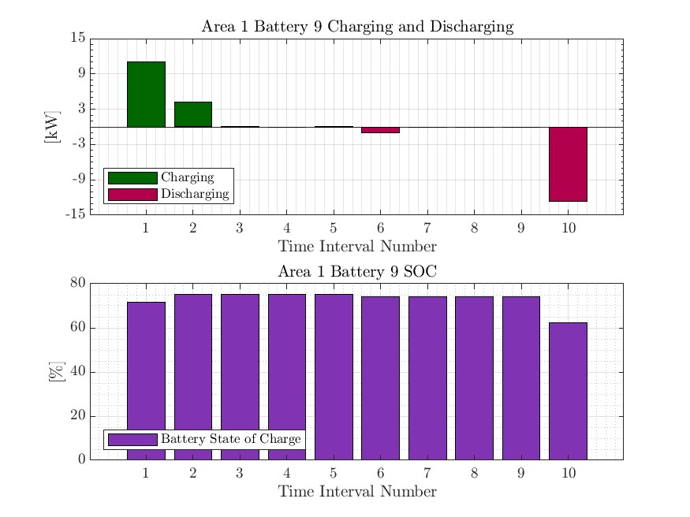

MPCOPF Verified for $T=10, PV=10\%, Batt=15\%$
strLoadShape = 'New Loadshape.LoadShape npts =5 interval = 1 mult = [0.7 0.85 1 0.85 0.7]'
strLoadShapePV = 'New Loadshape.LoadShapePV npts =5 interval = 1 mult = [1 1.2828 1.4 1.1 0.8]'
Alternative Profiles

Slide 18



Boundary Complex Powers
strLoadShape = 'New Loadshape.LoadShape npts =5 interval = 1 mult = [0.7 0.85 1 0.85 0.7]'
MPDOPF Verified for $T=5, PV=10\%, Batt=15\%$
strLoadShapePV = 'New Loadshape.LoadShapePV npts =5 interval = 1 mult = [1 1.2828 1.4 1.1 0.8]'
Alternative Profiles

Slide 19



Boundary Voltages
strLoadShape = 'New Loadshape.LoadShape npts =5 interval = 1 mult = [0.7 0.85 1 0.85 0.7]'
MPDOPF Verified for $T=5, PV=10\%, Batt=15\%$
strLoadShapePV = 'New Loadshape.LoadShapePV npts =5 interval = 1 mult = [1 1.2828 1.4 1.1 0.8]'
Alternative Profiles

Slide 20





MPDOPF Verified for $T=8, PV=10\%, Batt=15\%$
strLoadShape = 'New Loadshape.LoadShape npts =8 interval = 1 mult = [0.705 0.75 0.777 0.787 0.796 0.782 0.783 0.789]'
strLoadShapePV = 'New Loadshape.LoadShapePV npts =8 interval = 1 mult = [0.3 0.5 0.8 0.9 1 1 0.99 0.9]'
MPDOPF Simulation Results
OpenDSS Powerflow Results

Slide 21





MPCOPF Verified for $T=8, PV=10\%, Batt=15\%$
strLoadShape = 'New Loadshape.LoadShape npts =8 interval = 1 mult = [0.705 0.75 0.777 0.787 0.796 0.782 0.783 0.789]'
strLoadShapePV = 'New Loadshape.LoadShapePV npts =8 interval = 1 mult = [0.3 0.5 0.8 0.9 1 1 0.99 0.9]'
MPCOPF Simulation Results
OpenDSS Powerflow Results

Slide 22





MPDOPF Verified for $T=8, PV=10\%, Batt=15\%$
strLoadShape = 'New Loadshape.LoadShape npts =8 interval = 1 mult = [0.705 0.75 0.777 0.787 0.796 0.782 0.783 0.789]'
1, 5, 6, 8 in COPF values
strLoadShapePV = 'New Loadshape.LoadShapePV npts =8 interval = 1 mult = [0.3 0.5 0.8 0.9 1 1 0.99 0.9]'

Slide 23





MPCOPF Verified for $T=8, PV=10\%, Batt=15\%$
strLoadShape = 'New Loadshape.LoadShape npts =8 interval = 1 mult = [0.705 0.75 0.777 0.787 0.796 0.782 0.783 0.789]'
strLoadShapePV = 'New Loadshape.LoadShapePV npts =8 interval = 1 mult = [0.3 0.5 0.8 0.9 1 1 0.99 0.9]'

Slide 24




Boundary Complex Powers
strLoadShape = 'New Loadshape.LoadShape npts =8 interval = 1 mult = [0.705 0.75 0.777 0.787 0.796 0.782 0.783 0.789]'
MPDOPF Verified for $T=8, PV=10\%, Batt=15\%$
strLoadShapePV = 'New Loadshape.LoadShapePV npts =8 interval = 1 mult = [0.3 0.5 0.8 0.9 1 1 0.99 0.9]'

Slide 25



Boundary Voltages
strLoadShape = 'New Loadshape.LoadShape npts =8 interval = 1 mult = [0.705 0.75 0.777 0.787 0.796 0.782 0.783 0.789]'
MPDOPF Verified for $T=8, PV=10\%, Batt=15\%$
strLoadShapePV = 'New Loadshape.LoadShapePV npts =8 interval = 1 mult = [0.3 0.5 0.8 0.9 1 1 0.99 0.9]'

Slide 26


MPDOPF Verified for $T=9, PV=10\%, Batt=15\%$
strLoadShape = 'New Loadshape.LoadShape npts =9 interval = 1 mult = [0.668 0.705 0.75 0.777 0.787 0.796 0.782 0.783 0.789]'
strLoadShapePV = 'New Loadshape.LoadShapePV npts =9 interval = 1 mult = [0.2 0.3 0.5 0.8 0.9 1 1 0.99 0.9]'
MPDOPF Simulation Results
OpenDSS Powerflow Results

Slide 27





MPCOPF Verified for $T=9, PV=10\%, Batt=15\%$
strLoadShape = 'New Loadshape.LoadShape npts =9 interval = 1 mult = [0.668 0.705 0.75 0.777 0.787 0.796 0.782 0.783 0.789]'
strLoadShapePV = 'New Loadshape.LoadShapePV npts =9 interval = 1 mult = [0.2 0.3 0.5 0.8 0.9 1 1 0.99 0.9]'
MPCOPF Simulation Results
OpenDSS Powerflow Results

Slide 28








MPDOPF Verified for $T=9, PV=10\%, Batt=15\%$
strLoadShape = 'New Loadshape.LoadShape npts =9 interval = 1 mult = [0.668 0.705 0.75 0.777 0.787 0.796 0.782 0.783 0.789]'
strLoadShapePV = 'New Loadshape.LoadShapePV npts =9 interval = 1 mult = [0.2 0.3 0.5 0.8 0.9 1 1 0.99 0.9]'

Slide 29








MPCOPF Verified for $T=9, PV=10\%, Batt=15\%$
strLoadShape = 'New Loadshape.LoadShape npts =9 interval = 1 mult = [0.668 0.705 0.75 0.777 0.787 0.796 0.782 0.783 0.789]'
strLoadShapePV = 'New Loadshape.LoadShapePV npts =9 interval = 1 mult = [0.2 0.3 0.5 0.8 0.9 1 1 0.99 0.9]'

Slide 30




Boundary Complex Powers
strLoadShape = 'New Loadshape.LoadShape npts =9 interval = 1 mult = [0.668 0.705 0.75 0.777 0.787 0.796 0.782 0.783 0.789]'
MPDOPF Verified for $T=9, PV=10\%, Batt=15\%$
strLoadShapePV = 'New Loadshape.LoadShapePV npts =9 interval = 1 mult = [0.2 0.3 0.5 0.8 0.9 1 1 0.99 0.9]'

Slide 31



Boundary Voltages
strLoadShape = 'New Loadshape.LoadShape npts =9 interval = 1 mult = [0.668 0.705 0.75 0.777 0.787 0.796 0.782 0.783 0.789]'
MPDOPF Verified for $T=9, PV=10\%, Batt=15\%$
strLoadShapePV = 'New Loadshape.LoadShapePV npts =9 interval = 1 mult = [0.2 0.3 0.5 0.8 0.9 1 1 0.99 0.9]'

Slide 32





MPDOPF Verified for $T=10, PV=10\%, Batt=15\%$
strLoadShape = 'New Loadshape.LoadShape npts =10 interval = 1 mult = [0.668 0.705 0.75 0.777 0.787 0.796 0.782 0.783 0.789 0.826]'
strLoadShapePV = 'New Loadshape.LoadShapePV npts =10 interval = 1 mult = [0.2 0.3 0.5 0.8 0.9 1 1 0.99 0.9 0.7]'
MPDOPF Simulation Results
OpenDSS Powerflow Results

Slide 33





MPCOPF Verified for $T=10, PV=10\%, Batt=15\%$
strLoadShape = 'New Loadshape.LoadShape npts =10 interval = 1 mult = [0.668 0.705 0.75 0.777 0.787 0.796 0.782 0.783 0.789 0.826]'
strLoadShapePV = 'New Loadshape.LoadShapePV npts =10 interval = 1 mult = [0.2 0.3 0.5 0.8 0.9 1 1 0.99 0.9 0.7]'
MPCOPF Simulation Results
OpenDSS Powerflow Results

Slide 34




MPDOPF Verified for $T=10, PV=10\%, Batt=15\%$
strLoadShape = 'New Loadshape.LoadShape npts =10 interval = 1 mult = [0.668 0.705 0.75 0.777 0.787 0.796 0.782 0.783 0.789 0.826]'
strLoadShapePV = 'New Loadshape.LoadShapePV npts =10 interval = 1 mult = [0.2 0.3 0.5 0.8 0.9 1 1 0.99 0.9 0.7]'

Slide 35
MPCOPF Verified for $T=10, PV=10\%, Batt=15\%$
strLoadShape = 'New Loadshape.LoadShape npts =10 interval = 1 mult = [0.668 0.705 0.75 0.777 0.787 0.796 0.782 0.783 0.789 0.826]'
strLoadShapePV = 'New Loadshape.LoadShapePV npts =10 interval = 1 mult = [0.2 0.3 0.5 0.8 0.9 1 1 0.99 0.9 0.7]'

Slide 36




Boundary Complex Powers
MPDOPF Verified for $T=10, PV=10\%, Batt=15\%$

Slide 37



Boundary Voltages
MPDOPF Verified for $T=10, PV=10\%, Batt=15\%$

Slide 38
MPDOPF Verified for $T=5, PV=10\%, Batt=15\%$
strLoadShape = 'New Loadshape.LoadShape npts =5 interval = 1 mult = [0.75 0.777 0.787 0.796 0.782]'
strLoadShapePV = 'New Loadshape.LoadShapePV npts =5 interval = 1 mult = [0.5 0.8 0.9 1 1]'
MPDOPF Simulation Results
OpenDSS Powerflow Results

Slide 39
MPCOPF Verified for $T=5, PV=10\%, Batt=15\%$
strLoadShape = 'New Loadshape.LoadShape npts =5 interval = 1 mult = [0.75 0.777 0.787 0.796 0.782]'
strLoadShapePV = 'New Loadshape.LoadShapePV npts =5 interval = 1 mult = [0.5 0.8 0.9 1 1]'
MPCOPF Simulation Results
OpenDSS Powerflow Results

Slide 40
MPDOPF Verified for $T=10, PV=10\%, Batt=15\%$
strLoadShape = 'New Loadshape.LoadShape npts =10 interval = 1 mult = [0.668 0.705 0.75 0.777 0.787 0.796 0.782 0.783 0.789 0.826]'
strLoadShapePV = 'New Loadshape.LoadShapePV npts =10 interval = 1 mult = [0.2 0.3 0.5 0.8 0.9 1 1 0.99 0.9 0.7]'

Slide 41
MPCOPF Verified for $T=10, PV=10\%, Batt=15\%$
strLoadShape = 'New Loadshape.LoadShape npts =10 interval = 1 mult = [0.668 0.705 0.75 0.777 0.787 0.796 0.782 0.783 0.789 0.826]'
strLoadShapePV = 'New Loadshape.LoadShapePV npts =10 interval = 1 mult = [0.2 0.3 0.5 0.8 0.9 1 1 0.99 0.9 0.7]'

Slide 42
Boundary Complex Powers
strLoadShape = 'New Loadshape.LoadShape npts =10 interval = 1 mult = [0.668 0.705 0.75 0.777 0.787 0.796 0.782 0.783 0.789 0.826]'
MPDOPF Verified for $T=5, PV=10\%, Batt=15\%$
strLoadShapePV = 'New Loadshape.LoadShapePV npts =10 interval = 1 mult = [0.2 0.3 0.5 0.8 0.9 1 1 0.99 0.9 0.7]'

Slide 43
Boundary Voltages
strLoadShape = 'New Loadshape.LoadShape npts =10 interval = 1 mult = [0.668 0.705 0.75 0.777 0.787 0.796 0.782 0.783 0.789 0.826]'
MPDOPF Verified for $T=5, PV=10\%, Batt=15\%$
strLoadShapePV = 'New Loadshape.LoadShapePV npts =10 interval = 1 mult = [0.2 0.3 0.5 0.8 0.9 1 1 0.99 0.9 0.7]'

Slide 44

Latest Slides End Here.
Previous Slides Follow

Slide 45





MPDOPF Verified for $T=1, PV=10\%, Batt=0\%$
strLoadShape = 'New Loadshape.LoadShape npts =1 interval = 1 mult = [0.787]'
strLoadShapePV = 'New Loadshape.LoadShapePV npts =1 interval = 1 mult = [0.9]'
MPDOPF Simulation Results
OpenDSS Powerflow Results

Slide 46





MPCOPF Verified for $T=1, PV=10\%, Batt=0\%$
strLoadShape = 'New Loadshape.LoadShape npts =1 interval = 1 mult = [0.787]'
strLoadShapePV = 'New Loadshape.LoadShapePV npts =1 interval = 1 mult = [0.9]'
MPCOPF Simulation Results
OpenDSS Powerflow Results

Slide 47





MPDOPF Verified for $T=1, PV=10\%, Batt=15\%$
strLoadShape = 'New Loadshape.LoadShape npts =1 interval = 1 mult = [0.787]'
strLoadShapePV = 'New Loadshape.LoadShapePV npts =1 interval = 1 mult = [0.9]'
MPDOPF Simulation Results
OpenDSS Powerflow Results

Slide 48





MPCOPF Verified for $T=1, PV=10\%, Batt=15\%$
strLoadShape = 'New Loadshape.LoadShape npts =1 interval = 1 mult = [0.787]'
strLoadShapePV = 'New Loadshape.LoadShapePV npts =1 interval = 1 mult = [0.9]'
MPCOPF Simulation Results
OpenDSS Powerflow Results

Slide 49





MPDOPF Verified for $T=2, PV=10\%, Batt=15\%$
strLoadShape = 'New Loadshape.LoadShape npts =2 interval = 1 mult = [0.787 0.796]'
strLoadShapePV = 'New Loadshape.LoadShapePV npts =2 interval = 1 mult = [0.9 1]'
MPDOPF Simulation Results
OpenDSS Powerflow Results

Slide 50





MPCOPF Verified for $T=2, PV=10\%, Batt=15\%$
strLoadShape = 'New Loadshape.LoadShape npts =2 interval = 1 mult = [0.787 0.796]'
strLoadShapePV = 'New Loadshape.LoadShapePV npts =2 interval = 1 mult = [0.9 1]'
MPCOPF Simulation Results
OpenDSS Powerflow Results

Slide 51
MPDOPF Verified for $T=3, PV=10\%, Batt=15\%$
strLoadShape = 'New Loadshape.LoadShape npts =3 interval = 1 mult = [0.777 0.787 0.796]'
strLoadShapePV = 'New Loadshape.LoadShapePV npts =3 interval = 1 mult = [0.8 0.9 1]'
MPDOPF Simulation Results
OpenDSS Powerflow Results

Slide 52




MPCOPF Verified for $T=3, PV=10\%, Batt=15\%$
strLoadShape = 'New Loadshape.LoadShape npts =3 interval = 1 mult = [0.777 0.787 0.796]'
strLoadShapePV = 'New Loadshape.LoadShapePV npts =3 interval = 1 mult = [0.8 0.9 1]'
MPCOPF Simulation Results
OpenDSS Powerflow Results

Slide 53




MPDOPF Verified for $T=5, PV=10\%, Batt=15\%$
strLoadShape = 'New Loadshape.LoadShape npts =5 interval = 1 mult = [0.75 0.777 0.787 0.796 0.782]'
strLoadShapePV = 'New Loadshape.LoadShapePV npts =5 interval = 1 mult = [0.5 0.8 0.9 1 1]'
MPDOPF Simulation Results
OpenDSS Powerflow Results

Slide 54




MPCOPF Verified for $T=5, PV=10\%, Batt=15\%$
strLoadShape = 'New Loadshape.LoadShape npts =5 interval = 1 mult = [0.75 0.777 0.787 0.796 0.782]'
strLoadShapePV = 'New Loadshape.LoadShapePV npts =5 interval = 1 mult = [0.5 0.8 0.9 1 1]'
MPCOPF Simulation Results
OpenDSS Powerflow Results

Slide 55





MPDOPF Verified for $T=5, PV=10\%, Batt=15\%$
strLoadShape = 'New Loadshape.LoadShape npts =5 interval = 1 mult = [0.75 0.777 0.787 0.796 0.782]'
strLoadShapePV = 'New Loadshape.LoadShapePV npts =5 interval = 1 mult = [0.5 0.8 0.9 1 1]'

Slide 56





MPCOPF Verified for $T=5, PV=10\%, Batt=15\%$
strLoadShape = 'New Loadshape.LoadShape npts =5 interval = 1 mult = [0.75 0.777 0.787 0.796 0.782]'
strLoadShapePV = 'New Loadshape.LoadShapePV npts =5 interval = 1 mult = [0.5 0.8 0.9 1 1]'

Slide 57



Boundary Complex Powers
MPDOPF Verified for $T=5, PV=10\%, Batt=15\%$

Slide 58



Boundary Voltages
MPDOPF Verified for $T=5, PV=10\%, Batt=15\%$

Slide 59




MPDOPF Verified for $T=10, PV=10\%, Batt=15\%$
strLoadShape = 'New Loadshape.LoadShape npts =10 interval = 1 mult = [0.668 0.705 0.75 0.777 0.787 0.796 0.782 0.783 0.789 0.826]'
strLoadShapePV = 'New Loadshape.LoadShapePV npts =10 interval = 1 mult = [0.2 0.3 0.5 0.8 0.9 1 1 0.99 0.9 0.7]'
MPDOPF Simulation Results
OpenDSS Powerflow Results

Slide 60




MPCOPF Verified for $T=10, PV=10\%, Batt=15\%$
strLoadShape = 'New Loadshape.LoadShape npts =10 interval = 1 mult = [0.668 0.705 0.75 0.777 0.787 0.796 0.782 0.783 0.789 0.826]'
strLoadShapePV = 'New Loadshape.LoadShapePV npts =10 interval = 1 mult = [0.2 0.3 0.5 0.8 0.9 1 1 0.99 0.9 0.7]'
MPCOPF Simulation Results
OpenDSS Powerflow Results

Slide 61





MPDOPF Verified for $T=10, PV=10\%, Batt=15\%$
strLoadShape = 'New Loadshape.LoadShape npts =10 interval = 1 mult = [0.668 0.705 0.75 0.777 0.787 0.796 0.782 0.783 0.789 0.826]'
strLoadShapePV = 'New Loadshape.LoadShapePV npts =10 interval = 1 mult = [0.2 0.3 0.5 0.8 0.9 1 1 0.99 0.9 0.7]'

Slide 62





MPCOPF Verified for $T=10, PV=10\%, Batt=15\%$
strLoadShape = 'New Loadshape.LoadShape npts =10 interval = 1 mult = [0.668 0.705 0.75 0.777 0.787 0.796 0.782 0.783 0.789 0.826]'
strLoadShapePV = 'New Loadshape.LoadShapePV npts =10 interval = 1 mult = [0.2 0.3 0.5 0.8 0.9 1 1 0.99 0.9 0.7]'

Slide 63



Boundary Complex Powers
MPDOPF Verified for $T=10, PV=10\%, Batt=15\%$

Slide 64



Boundary Voltages
MPDOPF Verified for $T=10, PV=10\%, Batt=15\%$

Slide 65

MPDOPF Verified for $T=t, PV=10\%, Batt=15\%$
strLoadShape = 'New Loadshape.LoadShape npts =1 interval = 1 mult = [0.787]'
strLoadShapePV = 'New Loadshape.LoadShapePV npts =1 interval = 1 mult = [0.9]'
MPDOPF Simulation Results
OpenDSS Powerflow Results

Slide 66

MPCOPF Verified for $T=t, PV=10\%, Batt=15\%$
strLoadShape = 'New Loadshape.LoadShape npts =1 interval = 1 mult = [0.787]'
strLoadShapePV = 'New Loadshape.LoadShapePV npts =1 interval = 1 mult = [0.9]'
MPCOPF Simulation Results
OpenDSS Powerflow Results

Slide 67









MPDOPF Verified for $T=1, PV=10\%, Batt=10\%$
strLoadShape = 'New Loadshape.LoadShape npts =1 interval = 1 mult = [0.787]'
strLoadShapePV = 'New Loadshape.LoadShapePV npts =1 interval = 1 mult = [0.9]'
MPDOPF Simulation Results
OpenDSS Powerflow Results
$10\%$GED = $11$ buses

Slide 68








MPCOPF Verified for $T=1, PV=10\%, Batt=10\%$
strLoadShape = 'New Loadshape.LoadShape npts =1 interval = 1 mult = [0.787]'
strLoadShapePV = 'New Loadshape.LoadShapePV npts =1 interval = 1 mult = [0.9]'
MPCOPF Simulation Results
OpenDSS Powerflow Results
$10\%$GED = $11$ buses

Slide 69






MPDOPF Verified for $T=1, PV=100\%, Batt=100\%$
strLoadShape = 'New Loadshape.LoadShape npts =1 interval = 1 mult = [0.787]'
strLoadShapePV = 'New Loadshape.LoadShapePV npts =1 interval = 1 mult = [0.9]'
MPDOPF Simulation Results
OpenDSS Powerflow Results
$100\%$GED = $85$ buses

Slide 70





MPCOPF Verified for $T=1, PV=100\%, Batt=100\%$
strLoadShape = 'New Loadshape.LoadShape npts =1 interval = 1 mult = [0.787]'
strLoadShapePV = 'New Loadshape.LoadShapePV npts =1 interval = 1 mult = [0.9]'
MPCOPF Simulation Results
OpenDSS Powerflow Results
$100\%$GED = $85$ buses

Slide 71






MPDOPF Verified for $T=5, PV=10\%, Batt=10\%$
strLoadShape = 'New Loadshape.LoadShape npts =5 interval = 1 mult = [0.75 0.777 0.787 0.796 0.782]'
strLoadShapePV = 'New Loadshape.LoadShapePV npts =5 interval = 1 mult = [0.5 0.8 0.9 1 1]'
MPDOPF Simulation Results
OpenDSS Powerflow Results
$10\%$GED = $11$ buses

Slide 72






MPCOPF Verified for $T=5, PV=10\%, Batt=10\%$
strLoadShape = 'New Loadshape.LoadShape npts =5 interval = 1 mult = [0.75 0.777 0.787 0.796 0.782]'
strLoadShapePV = 'New Loadshape.LoadShapePV npts =5 interval = 1 mult = [0.5 0.8 0.9 1 1]'
MPCOPF Simulation Results
OpenDSS Powerflow Results
$10\%$GED = $9$ buses

Slide 73





MPDOPF Verified for $T=6, PV=10\%, Batt=10\%$
strLoadShape = 'New Loadshape.LoadShape npts =6 interval = 1 mult = [0.75 0.777 0.787 0.796 0.782 0.783]'
strLoadShapePV = 'New Loadshape.LoadShapePV npts =6 interval = 1 mult = [0.5 0.8 0.9 1 1 0.99]'
MPDOPF Simulation Results
OpenDSS Powerflow Results
$10\%$GED = $11$ buses

Slide 74





MPCOPF Verified for $T=6, PV=10\%, Batt=10\%$
strLoadShape = 'New Loadshape.LoadShape npts =6 interval = 1 mult = [0.75 0.777 0.787 0.796 0.782 0.783]'
strLoadShapePV = 'New Loadshape.LoadShapePV npts =6 interval = 1 mult = [0.5 0.8 0.9 1 1 0.99]'
MPCOPF Simulation Results
OpenDSS Powerflow Results
$10\%$GED = $9$ buses

Slide 75





MPDOPF Verified for $T=7, PV=10\%, Batt=10\%$
strLoadShape = 'New Loadshape.LoadShape npts =7 interval = 1 mult = [0.705 0.75 0.777 0.787 0.796 0.782 0.783]'
strLoadShapePV = 'New Loadshape.LoadShapePV npts =7 interval = 1 mult = [0.3 0.5 0.8 0.9 1 1 0.99]'
MPDOPF Simulation Results
OpenDSS Powerflow Results
$10\%$GED = $11$ buses

Slide 76





MPCOPF Verified for $T=7, PV=10\%, Batt=10\%$
strLoadShape = 'New Loadshape.LoadShape npts =7 interval = 1 mult = [0.705 0.75 0.777 0.787 0.796 0.782 0.783]'
strLoadShapePV = 'New Loadshape.LoadShapePV npts =7 interval = 1 mult = [0.3 0.5 0.8 0.9 1 1 0.99]'
MPCOPF Simulation Results
OpenDSS Powerflow Results
$10\%$GED = $9$ buses

Slide 77





MPDOPF Verified for $T=8, PV=10\%, Batt=10\%$
strLoadShape = 'New Loadshape.LoadShape npts =8 interval = 1 mult = [0.705 0.75 0.777 0.787 0.796 0.782 0.783 0.789]'
strLoadShapePV = 'New Loadshape.LoadShapePV npts =8 interval = 1 mult = [0.3 0.5 0.8 0.9 1 1 0.99 0.9]'
MPDOPF Simulation Results
OpenDSS Powerflow Results
$10\%$GED = $11$ buses

Slide 78





MPCOPF Verified for $T=8, PV=10\%, Batt=10\%$
strLoadShape = 'New Loadshape.LoadShape npts =8 interval = 1 mult = [0.705 0.75 0.777 0.787 0.796 0.782 0.783 0.789]'
strLoadShapePV = 'New Loadshape.LoadShapePV npts =8 interval = 1 mult = [0.3 0.5 0.8 0.9 1 1 0.99 0.9]'
MPCOPF Simulation Results
OpenDSS Powerflow Results
$10\%$GED = $9$ buses

Slide 79





MPDOPF Verified for $T=9, PV=10\%, Batt=10\%$
strLoadShape = 'New Loadshape.LoadShape npts =9 interval = 1 mult = [0.668 0.705 0.75 0.777 0.787 0.796 0.782 0.783 0.789]'
strLoadShapePV = 'New Loadshape.LoadShapePV npts =9 interval = 1 mult = [0.2 0.3 0.5 0.8 0.9 1 1 0.99 0.9]'
MPDOPF Simulation Results
OpenDSS Powerflow Results
$10\%$GED = $11$ buses

Slide 80





MPCOPF Verified for $T=9, PV=10\%, Batt=10\%$
strLoadShape = 'New Loadshape.LoadShape npts =9 interval = 1 mult = [0.668 0.705 0.75 0.777 0.787 0.796 0.782 0.783 0.789]'
strLoadShapePV = 'New Loadshape.LoadShapePV npts =9 interval = 1 mult = [0.2 0.3 0.5 0.8 0.9 1 1 0.99 0.9]'
MPCOPF Simulation Results
OpenDSS Powerflow Results
$10\%$GED = $9$ buses

Slide 81





MPDOPF Verified for $T=10, PV=10\%, Batt=10\%$
strLoadShape = 'New Loadshape.LoadShape npts =10 interval = 1 mult = [0.668 0.705 0.75 0.777 0.787 0.796 0.782 0.783 0.789 0.826]'
strLoadShapePV = 'New Loadshape.LoadShapePV npts =10 interval = 1 mult = [0.2 0.3 0.5 0.8 0.9 1 1 0.99 0.9 0.7]'
MPDOPF Simulation Results
OpenDSS Powerflow Results
$10\%$GED = $11$ buses

Slide 82





MPCOPF Verified for $T=10, PV=10\%, Batt=10\%$
strLoadShape = 'New Loadshape.LoadShape npts =10 interval = 1 mult = [0.668 0.705 0.75 0.777 0.787 0.796 0.782 0.783 0.789 0.826]'
strLoadShapePV = 'New Loadshape.LoadShapePV npts =10 interval = 1 mult = [0.2 0.3 0.5 0.8 0.9 1 1 0.99 0.9 0.7]'
MPCOPF Simulation Results
OpenDSS Powerflow Results
$10\%$GED = $9$ buses

Slide 83





MPDOPF Verified for $T=10, PV=10\%, Batt=10\%$
strLoadShape = 'New Loadshape.LoadShape npts =10 interval = 1 mult = [0.668 0.705 0.75 0.777 0.787 0.796 0.782 0.783 0.789 0.826]'
strLoadShapePV = 'New Loadshape.LoadShapePV npts =10 interval = 1 mult = [0.2 0.3 0.5 0.8 0.9 1 1 0.99 0.9 0.7]'

Slide 84



Boundary Complex Powers

Slide 85



Boundary Voltages

Slide 86





MPDOPF Verified for $T=11, PV=10\%, Batt=10\%$
strLoadShape = 'New Loadshape.LoadShape npts =11 interval = 1 mult = [0.644 0.668 0.705 0.75 0.777 0.787 0.796 0.782 0.783 0.789 0.826]'
strLoadShapePV = 'New Loadshape.LoadShapePV npts =11 interval = 1 mult = [0.1 0.2 0.3 0.5 0.8 0.9 1 1 0.99 0.9 0.7]'
MPDOPF Simulation Results
OpenDSS Powerflow Results
$10\%$GED = $11$ buses

Slide 87





MPCOPF Verified for $T=11, PV=10\%, Batt=10\%$
strLoadShape = 'New Loadshape.LoadShape npts =11 interval = 1 mult = [0.644 0.668 0.705 0.75 0.777 0.787 0.796 0.782 0.783 0.789 0.826]'
strLoadShapePV = 'New Loadshape.LoadShapePV npts =11 interval = 1 mult = [0.1 0.2 0.3 0.5 0.8 0.9 1 1 0.99 0.9 0.7]'
MPCOPF Simulation Results
OpenDSS Powerflow Results
$10\%$GED = $9$ buses

Slide 88


MPDOPF Verification: $$T=1, PV=30\%, Batt=30\%$$

Slide 89





MPDOPF Verified for $T=1, PV=30\%, Batt=30\%$
MPDOPF Simulation Results
OpenDSS Powerflow Results

Slide 90



MPDOPF Verification: $$T=2, PV=30\%, Batt=30\%$$

Slide 91






MPDOPF Verified for $T=2, PV=30\%, Batt=30\%$
MPDOPF Simulation Results
OpenDSS Powerflow Results

Slide 92




MPDOPF Verification: $$T=3, PV=10\%, Batt=10\%$$

Slide 93






MPDOPF Verified for $T=3, PV=10\%, Batt=10\%$
MPDOPF Simulation Results
OpenDSS Powerflow Results

Slide 94



MPDOPF Verification: $$T=4, PV=10\%, Batt=10\%$$

Slide 95






MPDOPF Verified for $T=4, PV=10\%, Batt=10\%$
strLoadShape = 'New Loadshape.LoadShape npts =4 interval = 1 mult = [0.777 0.787 0.796 0.782]'
strLoadShapePV = 'New Loadshape.LoadShapePV npts =4 interval = 1 mult = [0.8 0.9 1 1]'
MPDOPF Simulation Results
OpenDSS Powerflow Results

Slide 96



MPDOPF Verification: $$T=5, PV=10\%, Batt=10\%$$

Slide 97



MPDOPF Verification: $$T=5, PV=30\%, Batt=30\%$$

Slide 98





MPCOPF $T=5, PV=30\%, Batt=30\%$

Slide 99



MPDOPF Verification: $$T=5, PV=50\%, Batt=50\%$$

Slide 100





MPCOPF $T=5, PV=50\%, Batt=50\%$ sim terminated at 100 micro-iterations

Slide 101



MPDOPF Verification: $$T=5, PV=100\%, Batt=100\%$$

Slide 102



MPDOPF Verification: $$T=6, PV=10\%, Batt=10\%$$

Slide 103






MPDOPF Verified for $T=5, PV=30\%, Batt=30\%$
strLoadShape = 'New Loadshape.LoadShape npts =5 interval = 1 mult = [0.75 0.777 0.787 0.796 0.782]'
strLoadShapePV = 'New Loadshape.LoadShapePV npts =5 interval = 1 mult = [0.5 0.8 0.9 1 1]'
MPDOPF Simulation Results
OpenDSS Powerflow Results

Slide 104






MPDOPF Verified for $T=5, PV=50\%, Batt=50\%$
strLoadShape = 'New Loadshape.LoadShape npts =5 interval = 1 mult = [0.75 0.777 0.787 0.796 0.782]'
strLoadShapePV = 'New Loadshape.LoadShapePV npts =5 interval = 1 mult = [0.5 0.8 0.9 1 1]'
MPDOPF Simulation Results
OpenDSS Powerflow Results

Slide 105






MPDOPF Verified for $T=5, PV=100\%, Batt=100\%$
strLoadShape = 'New Loadshape.LoadShape npts =5 interval = 1 mult = [0.75 0.777 0.787 0.796 0.782]'
strLoadShapePV = 'New Loadshape.LoadShapePV npts =5 interval = 1 mult = [0.5 0.8 0.9 1 1]'
MPDOPF Simulation Results
OpenDSS Powerflow Results

Slide 106


MPDOPF: Mapping of Decentralized Variables to Centralized Variables done, everything packed into a structure suitable for OpenDSS Validation.
I had node numbers for $4$ Areas like $1:41$, $1:19, 1:20, 1:54$ but not a way to know which nodes do they refer to in the real ‘centralized’ system.
I (manually) created a mapping between the two.
I then used the mapping scheme to collate all ‘area information’ after optimization into a ‘system information’ for validating against OpenDSS.

Slide 107

How do other authors validate their OPF results?
[nazir2020tpwrs]
Feasibility of Solution: Forward-Backward Sweep in GridLab-D.
They check violation of node voltages between the simulation and the GridLab-D powerflow.
Optimality of Solution:
The authors argue that a) computing (even for verifying) Multi-Period NL OPF can be computationally too expensive and b) the solution to a ‘Decoupled’ NL-OPF (with battery set points already assigned by the Full Horizon SOCP OPF will provide an even lower optimal value compared to the Full Horizon NLP OPF (7).

Slide 108


How do other authors validate their OPF results?
[nazir2020tpwrs]
Optimality of Solution:
They formulate their optimality gap as a comparison between the SOCP optimal value and Decoupled NLP optimal value (9), for each time-step, and taking the maximum optimality gap to show as the result.
For IEEE 123, they get a maximum optimality gap of $2.1\%$. Violations against GridLab-D are small. (Feasible solution).

Slide 109

How do other authors validate their OPF results?
[nazir2020tpwrs]
Commentary on Solution Times:
Fig. (a) They see a similar trend in results as me when performing a Full Horizon NLP, with solution times becoming increasingly larger as the time-horizon increases.
Fig. (b) But their SOCP approach scales well, with solutions times increasingly almost linearly with time-horizon. For practical scenarios (day-ahead hourly simulation), their SOCP solution converges in under a minute.

Slide 110


How do other authors validate their OPF results?
[usman2022tpwrs]
Feasibility and Optimality of Solution:
They mainly showcase the benchmarks based on UK $31$ bus system.
They solve the full horizon (day-ahead hourly) OPF MINLP OPF in JuMP using BONMIN solver (here called $M0$).
They compare its objective function against their own linearized method (here called $M1$).
They get an optimality gap of less than $1\%$.
Infeasibilities are detected based on box-constraints (line-limits breached, bus voltage limits breached, etc.).

Slide 111
How do other authors validate their OPF results?
[agrawal2022tpwrs]
Other authors, sometimes use a different solution paradigm, and compare it against MATLAB’s fmincon.

Slide 112






MPCOPF Simulation has been verified for X% PVs and Y% Batteries Only for small horizons ($T≤8$) because of long simulation time.

Slide 113




$$T=1, PV=10\%, Batt=10\%$$

Slide 114





$$T=2, PV=10\%, Batt=10\%$$

Slide 115




$$T=2, PV=30\%, Batt=30\%$$

Slide 116





$$T=3, PV=10\%, Batt=10\%$$

Slide 117





$$T=4, PV=10\%, Batt=10\%$$

Slide 118





$$T=5, PV=10\%, Batt=10\%$$

Slide 119

$$T=5, PV=30\%, Batt=30\%$$

Slide 120


$$T=5, PV=30\%, Batt=30\%$$

Slide 121

$$T=5, PV=50\%, Batt=50\%$$ sim terminated at 100 micro-iterations

Slide 122


$$T=5, PV=50\%, Batt=50\%$$ sim terminated at 100 micro-iterations

Slide 123





$$T=6, PV=10\%, Batt=10\%$$

Slide 124


$$T=6, PV=10\%, Batt=10\%$$

Slide 125





$$T=7,PV=10\%, Batt=10\%$$

Slide 126





$$T=8,PV=10\%, Batt=10\%$$

Slide 127


$$T=8,PV=10\%, Batt=10\%$$

Slide 128





$$T=9,PV=10\%, Batt=10\%$$

Slide 129




$$T=1, PV=30\%, Batt=30\%$$

Slide 130





$$T=6, PV=30\%, Batt=30\%$$

Slide 131





$$T=6, PV=50\%, Batt=50\%$$

Slide 132

MPCOPF Simulation has been verified for X% PVs and Y% Batteries Only for small horizons ($T=5$) because of long simulation time.
MPCOPF Simulation Results
These slides will show results for a $5$-hour (hourly) $10\%$ PV $+ 10\%$Battery Simulation Validation for IEEE $123$ system, but I’ve validated for many other percentage penetrations too, for smaller time-steps.
For example, even this simulation took $500$ seconds on my $32$GB Office PC.
Even for the same $T$, increasing the GED penetration % increases the OPF solution time.
And even for small GED penetration percentage (10% each like the one done in these slides), increasing $T$ increases the simulation time by a lot.

Slide 133





MPCOPF Simulation has been verified for X% PVs and Y% Batteries Only for small horizons ($T≤5$) because of long simulation time.
MPCOPF Simulation Results
OpenDSS Powerflow Results
$10\%$ PVs + $10\%$ Batteries

Slide 134



Current Issue: Some mismatch in MPCOPF results Seeming mismatch between specified (from OPF) and assigned values (into OpenDSS) for Battery Reactive Powers

Slide 135




Currently Doing: Extracting Results on an Hourly (Time-step) Basis, for hourly comparison against OpenDSS

Slide 136





IEEE $123 X\%$PVs, $0\%$Batteries. COPF. $T = 1$
Objective Function values (Real Power Losses $P_{Loss}$) and System-wide Voltage snapshots (shown in the next slides) match.
This slide: $X=0$
Multi-Period Simulation, T = 1, Batteries at 0%, DERs at 0% ($0$ buses)
OpenDSS Powerflow with DERs at 0% ($0$ buses)

Slide 137




IEEE $123 X\%$PVs, $0\%$Batteries. COPF. $T = 1$
Objective Function values (Real Power Losses $P_{Loss}$) and System-wide Voltage snapshots (shown in the next slides) match.
This slide: $X=50$
Multi-Period Simulation, T = 1, Batteries at 0%, DERs at 50% ($43$ buses)
OpenDSS Powerflow with DERs at 50% ($43$ buses)

Slide 138




IEEE $123 X\%$PVs, $0\%$Batteries. COPF. $T = 1$
Objective Function values (Real Power Losses $P_{Loss}$) and System-wide Voltage snapshots (shown in the next slides) match.
This slide: $X=100$
Multi-Period Simulation, T = 1, Batteries at 0%, DERs at 100% ($85$ buses)
OpenDSS Powerflow with DERs at 100% ($85$ buses)

Slide 139







Comparison with OpenDSS: System-wide Voltage Snapshots PV = $0\%, 10\%, 20\%, 30\%, 40\%, 50\%$ Battery = $0\%$ $$T = 1$$

Slide 140






Comparison with OpenDSS: System-wide Voltage Snapshots PV = $60\%, 70\%, 80\%, 90\%, 100\%,$ Battery = $0\%$ $$T = 1$$

Slide 141






Comparison with OpenDSS: System-wide Voltage Snapshots Battery = $10\%, 20\%, 30\%, 40\%, 50\%$ PV = $0\%$ $$T = 1$$

Slide 142






Comparison with OpenDSS: System-wide Voltage Snapshots
PV = $0\%$ Battery = $60\%, 70\%, 80\%, 90\%, 100\%,$ $$T = 1$$

Slide 143






Comparison with OpenDSS: System-wide Voltage Snapshots
PV and Battery = $0\%, 10\%, 30\%, 50\%, 100\%$ $$T = 1$$

Slide 144





Trying to benchmark the “Benchmark” Simulation against the “Original” Simulation
$T$: Number of Time-Periods (tunable)
No Time-dimension: Equivalent to $T=1$
$numAreas$ : Number of Areas the system is divided into. The simulation becomes:
CMPOPF if $numAreas = 1$
DMPOPF if $numAreas > 1 (4)$
$numAreas$ : Number of Areas the system is divided into. The simulation becomes:
CMPOPF if $numAreas = 1$
DMPOPF if $numAreas > 1 (4)$
DERs (tunable): $[0, 100\%]$ ($0$ to $85$ buses)
Batteries# (tunable*): $[0, 100\%]$ ($0$ to $85$buses)
DERs (fixed): $100\%$ ($85$ buses)
No Batteries: Equivalent to $0\%$ ($0$ buses)
“Benchmark” Simulation: MP-(C/D)-OPF
“Original” Simulation: (C/D)-OPF

Slide 145








Trying to benchmark the “Benchmark” Simulation against the “Original” Simulation
#Batteries add more than just $4$ new decision variables (which are $B, P_{c}, P_{d}, q_{B}$) to the simulation.
Incorporating them (while avoiding mixed-integer programming) requires specifying additional ‘soft-constraint’ objective functions to the optimizer, including an “SCD penalty” function and a “Deviation of terminal SOC from a reference SOC penalty” function, which require additional unknown parameters (such as $α, γ$ in my simulation). Ideally, these ‘soft-constraint’ function values in the result should be zero, but if this doesn’t happen, they cannot be truly compared to a ‘battery-free’ simulation.
$T$: Number of Time-Periods (tunable)
No Time-dimension: Like $T=1$
$numAreas$ : Number of Areas the system is divided into. The simulation becomes:
CMPOPF if $numAreas = 1$
DMPOPF if $numAreas > 1 (4)$
$numAreas$ : Number of Areas the system is divided into. The simulation becomes:
CMPOPF if $numAreas = 1$
DMPOPF if $numAreas > 1 (4)$
DERs (tunable): $[0, 100\%]$ ($0$ to $85$ buses)
Batteries# (tunable*): $[0, 100\%]$ ($0$ to $85$buses)
DERs (fixed): $100\%$ ($85$ buses)
No Batteries: Like $0\%$ ($0$ buses)
“Benchmark” Simulation: MP-(C/D)-OPF
“Original” Simulation: (C/D)-OPF
*Note: The way the batteries are currently modeled, they can only be placed at a bus where there is already a DER. (So only $85$ buses are eligible to have a battery)

Slide 146







Trying to benchmark the “Benchmark” Simulation against the “Original” Simulation
But, if batteries are removed (unmodeled) from the MPOPF simulation, the previously mentioned complications are also avoided, and thus the two simulations can be compared toe-to-toe. This is what I’ve been doing recently.
$T$: Number of Time-Periods (tunable)
$$T=1$$
$numAreas=1$ (COPF)
$$\%DER=100$$
$$\%Batteries=0$$
No Time-dimension: Equivalent to $T=1$
$numAreas$ : Number of Areas the system is divided into. The simulation becomes:
CMPOPF if $numAreas = 1$
DMPOPF if $numAreas > 1 (4)$
$numAreas$ : Number of Areas the system is divided into. The simulation becomes:
CMPOPF if $numAreas = 1$
DMPOPF if $numAreas > 1 (4)$
DERs (tunable): $[0, 100\%]$ ($0$ to $85$ buses)
Batteries# (tunable*): $[0, 100\%]$ ($0$ to $85$buses)
DERs (fixed): $100\%$ ($85$ buses)
No Batteries: Equivalent to $0\%$ ($0$ buses)
“Benchmark” Simulation: MP-(C/D)-OPF
“Original” Simulation: (C/D)-OPF

Slide 147


IEEE $123 100\%$DER, $0\%$Batteries. COPF. $T = 1$
Current Status: My MPCOPF line loss result matches with the previous COPF line loss results, which still is a little off the OpenDSS line loss. Voltages (on the next page) match closely, but not completely. I don’t know the cause of the slight mismatch. (and whether it will blow up for bigger simulations, or not be an issue)
Multi-Period Simulation, T = 1, Batteries at 0%, DERs at 100% ($85$ buses)
OpenDSS Powerflow with DERs at 100% ($85$ buses)

Slide 148


Comparison with OpenDSS

Slide 149




IEEE $123 100\%$DER, $0\%$Batteries. COPF. $T = 1$
Problem: These values should be the same. This is an OPF modelling issue.
Multi-Period Simulation, T = 1, Batteries at 0%, DERs at 100% ($85$ buses)
Original Simulation* DERs at 100% ($85$ buses)
* Original Simulation = Simulation used by Rabayet to model DOPF on IEEE $123$ Bus System with $100\%$ DERs ($85$ buses). Obviously, there’s no element of time $($not modeled, so $T=1)$ and no batteries (not modeled, so $0\%$)

Slide 150

Current Approach: Validating OPF decision variables with OpenDSS
By setting
$P_{Load_OpenDSS}=P_{Load} −P_{DER} −P_{disch}+P_{chr}$
$Q_{Load_OpenDSS}=Q_{Load} −q_{DER} −q_{Batt}−Q_{Cap}$
Running Powerflow in OpenDSS, obtaining $V_{OpenDSS}$ and comparing against my simulation $V_{results}$ (checking for physical violations, but also, just checking the two $V$vs bus-number curves in general).
I’m writing an OpenDSS validator function, which takes busData, branchData, $P_{Load}, P_{DER}, P_{disch}, P_{chr}, Q_{Load}, q_{DER}, q_{Batt}, Q_{cap}, V_{results}$ for a given time-interval $t$and plots its powerflow voltages $V_{OpenDSS}$ against my $V_{results}$.

Slide 151

Comparison with OpenDSS confirms that the current MPCOPF model has issues

Slide 152
References
[nazir2018pscc] Nazir, N., & Almassalkhi, M. . Receding-Horizon Optimization of Unbalanced Distribution Systems with Time-Scale Separation for Discrete and Continuous Control Devices. 2018 Power Systems Computation Conference (PSCC). IEEE. doi: 10.23919/PSCC.2018.8442555
[nazir2020tpwrs] Nazir, N., Racherla, P., & Almassalkhi, M. (2020). Optimal Multi-Period Dispatch of Distributed Energy Resources in Unbalanced Distribution Feeders. IEEE Trans. Power Syst., 35(4), 2683–2692. doi: 10.1109/TPWRS.2019.2963249
[usman2022tpwrs] Usman, M., & Capitanescu, F. (2022). A Novel Tractable Methodology to Stochastic Multi-Period AC OPF in Active Distribution Systems Using Sequential Linearization Algorithm. IEEE Trans. Power Syst., 38(4), 3869–3883. doi: 10.1109/TPWRS.2022.3197884

Slide 153




(IEEE 123 System divided into) 4 Area System

